Slide 1
JSON
JavaScript Object Notation

Slide 2
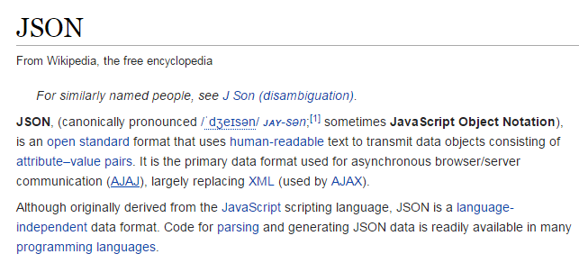

Slide 3
http://www.jsoneditoronline.org/

Slide 4
http://json.org/

Slide 5
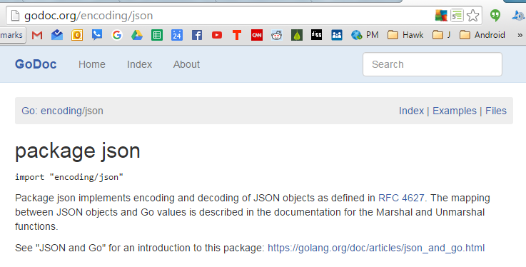

Slide 6
Encoder, Decoder
Marshal, Unmarshal

Slide 7
Encoder, Decoder
Marshal, Unmarshal
to JSON
from JSON

Slide 8
Encoder, Decoder
Marshal, Unmarshal
to JSON
from JSON
reader, writer
[]bytes

Slide 9
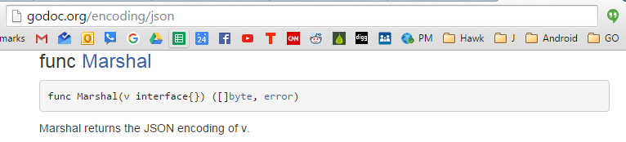

Slide 10
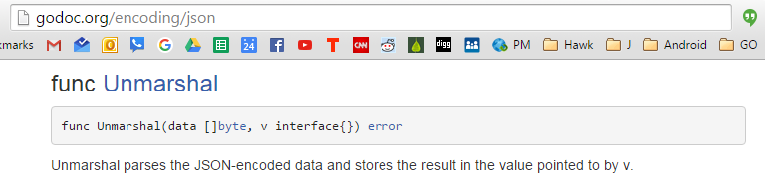

Slide 11
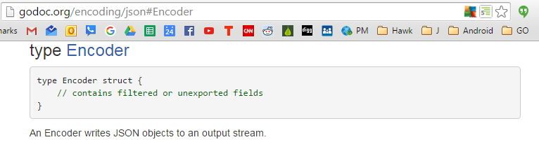

Slide 12
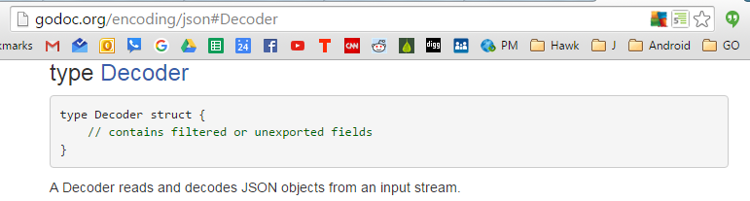

Slide 13
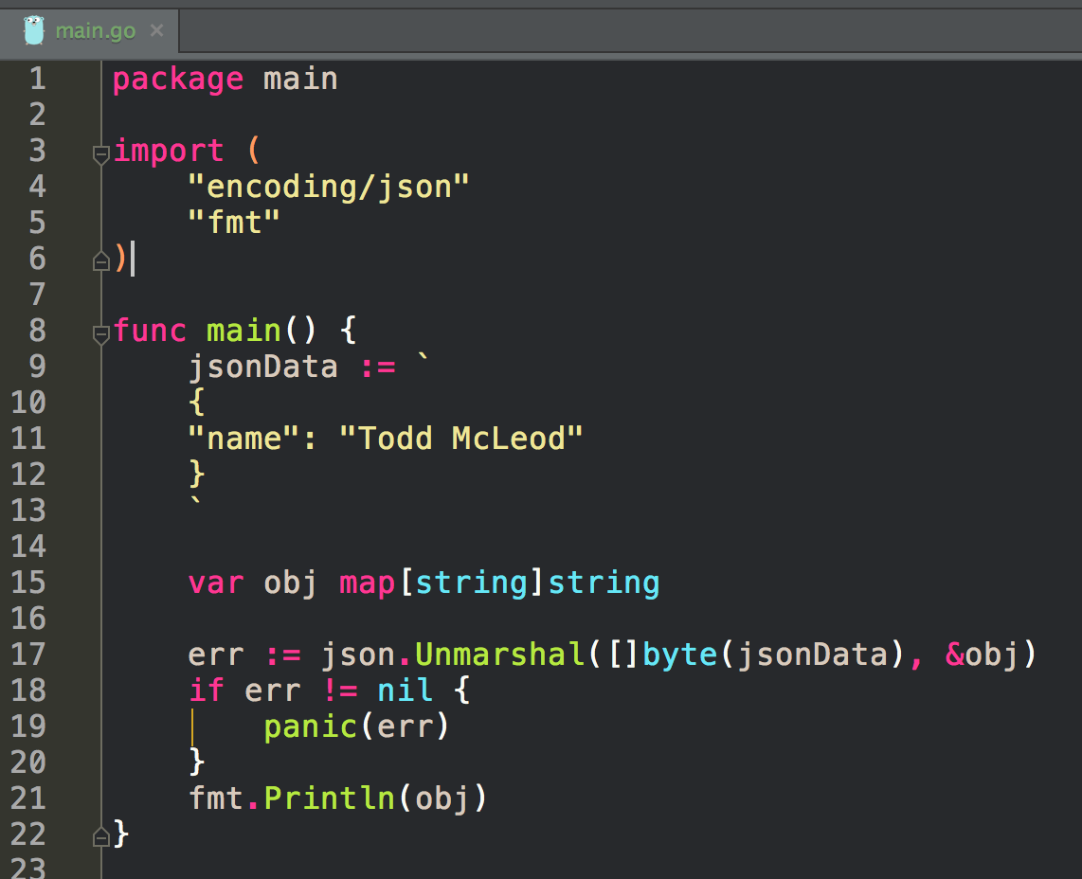
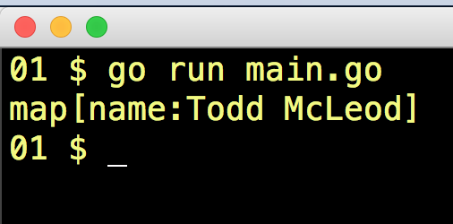
Unmarshal

Slide 14
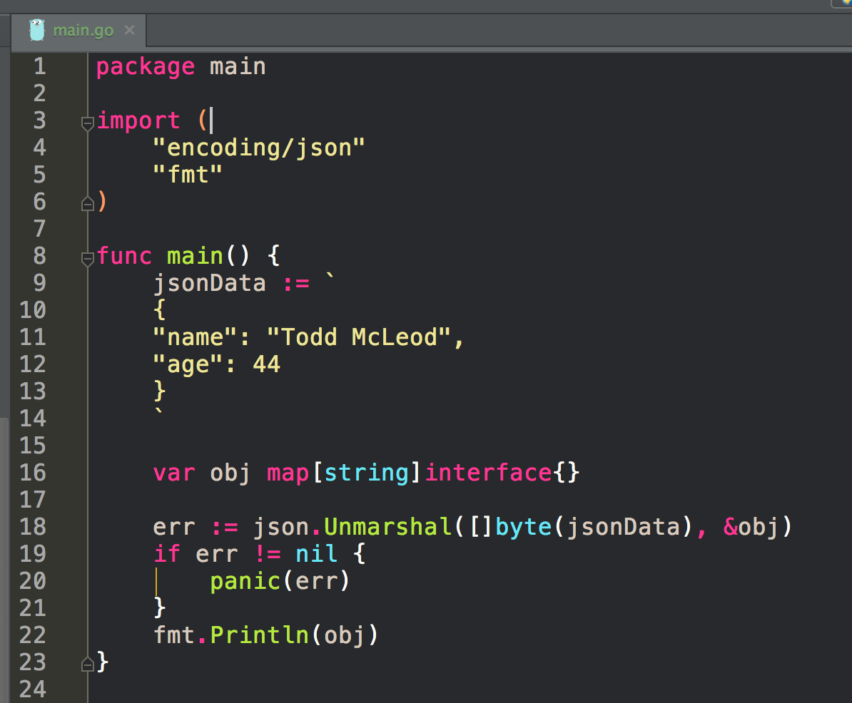
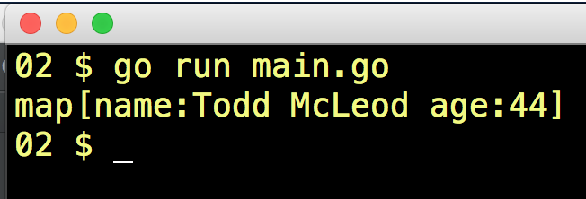
Unmarshal

Slide 15
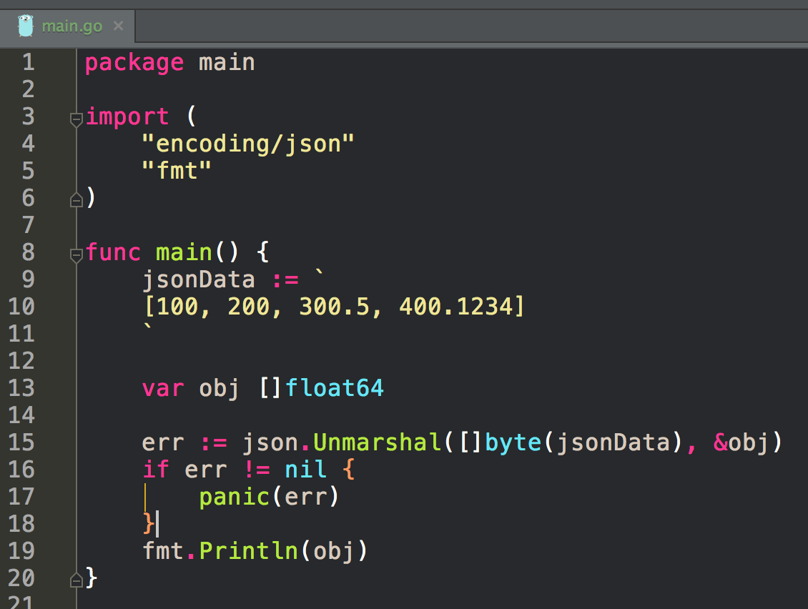
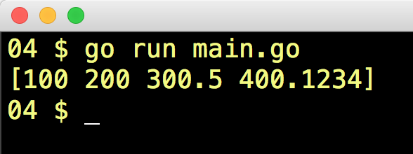
Unmarshal

Slide 16
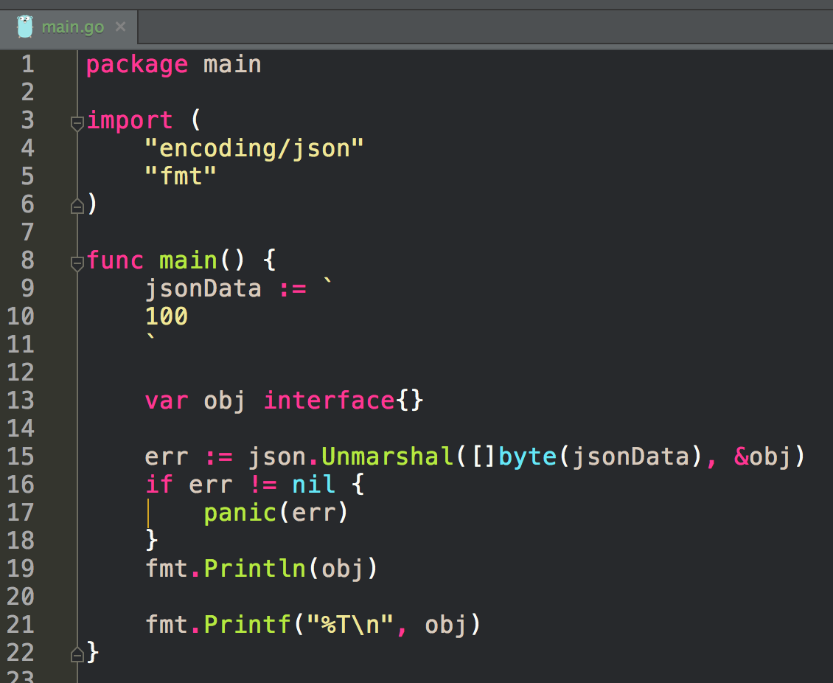
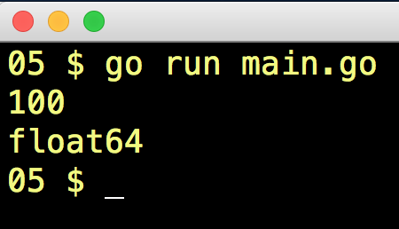
Unmarshal

Slide 17
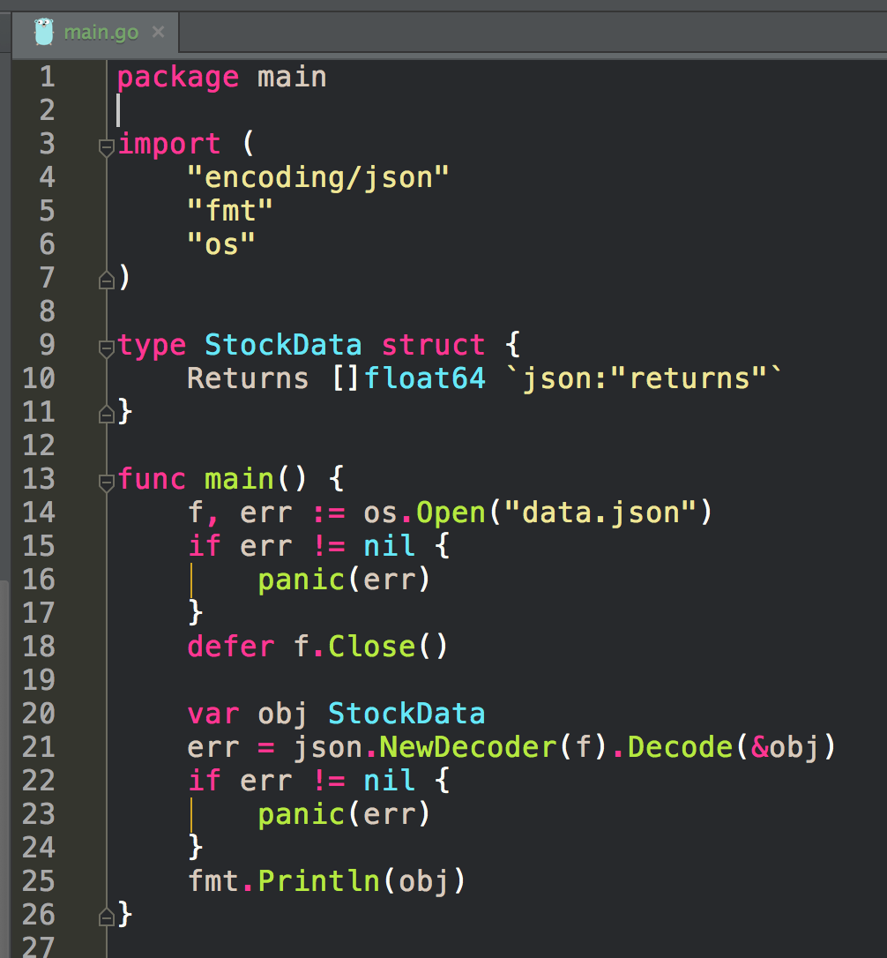
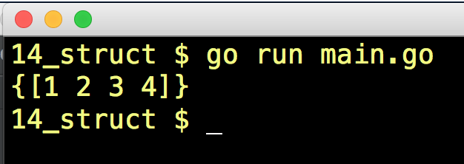
Unmarshal

Slide 18
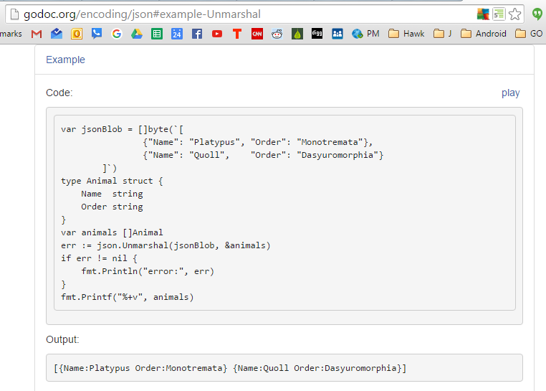
Unmarshal

Slide 19
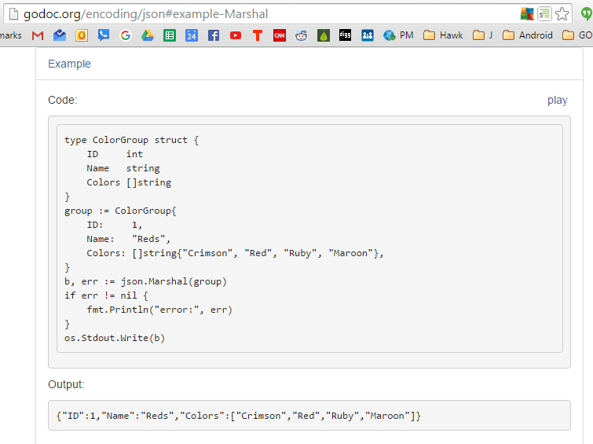
Marshal

Slide 20
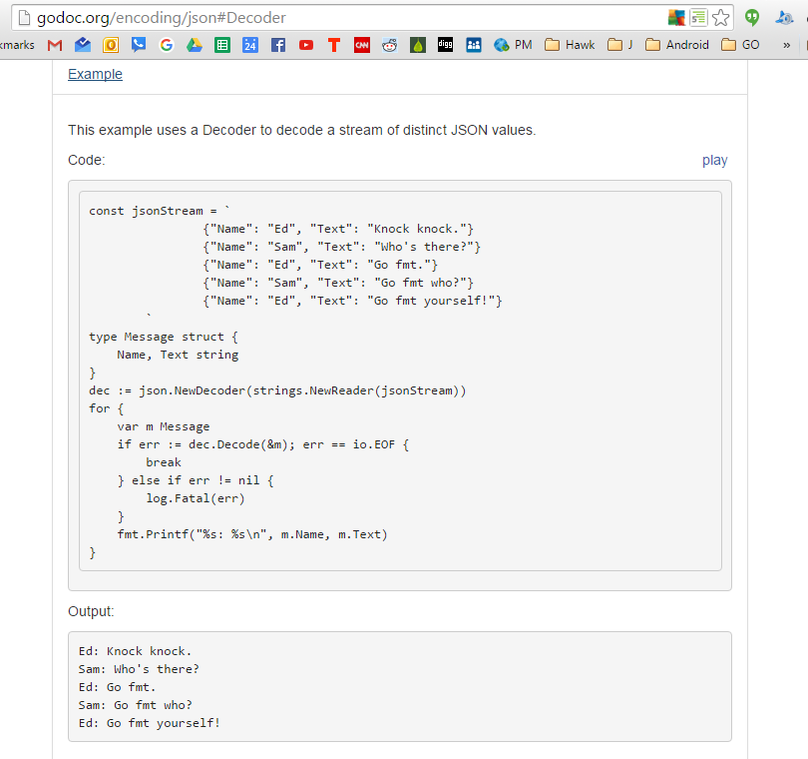
Decoder

Slide 21
exercises

Slide 22
JSON
Create a struct, encode it as JSON, and write it out to stdout.

Slide 23
JSON
Create a JSON file
Create a program that reads that JSON file into a struct, then writes it to stdout.

Slide 24
JSON
Create a program which can read a csv file and write it as a JSON file.

